Slide 1
Week 4– Individual Behaviour in Organizations

Slide 2
Perception and Psychological Contracts
Perception
  The process through which people receive and interpret information from the environment.
Psychological contract
  The set of expectations held by an individual about working relationships with the organisation.
A healthy psychological contract offers a balance between contributions made to the organisation and inducements received in return.
  A person offers contributions, or valued work activities, such as effort, time, creativity and loyalty.
  Inducements are things of value that the organisation gives to the individual, e.g. pay.
Notes:
Perceptions, personalities, attitudes, emotions and moods all influence individual behaviour at work. When people work under conditions that fail to provide them with respect, their behaviour is more likely to tend towards low performance, poor customer service, absenteeism and even being antisocial. But when people work in supportive settings, more positive work behaviours — higher performance, less withdrawal and dysfunction — are common.
Psychological contracts
Work should involve a positive give and take, or exchange of values, between the individual and the organisation.
A psychological contract is the set of expectations held by an individual about working relationships with the organisation.
The ideal work situation is one in which the exchange of values in the psychological contract is considered fair. When the psychological contract is broken, however, morale problems easily develop.
A healthy psychological contract offers a balance between contributions made to the organisation and inducements received in return. A person offers contributions, or valued work activities, such as effort, time, creativity and loyalty. These are among the things that make the individual a desirable resource.
Inducements are things of value that the organisation gives to the individual in exchange for these contributions.
Typical inducements include pay, fringe benefits, training and opportunities for personal growth and advancement. Such inducements should be valued by employees and should make it worthwhile for them to work hard for the organisation.

Slide 3
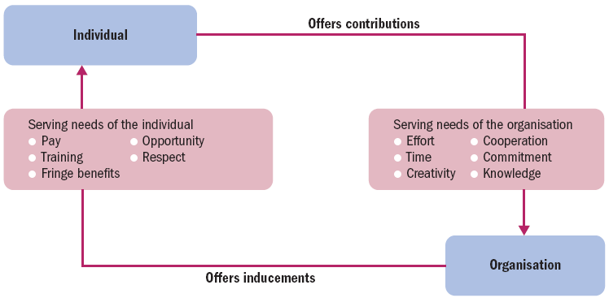
The psychological contract
Notes:
Components in the psychological contract.

Slide 4
Perception distortions
Stereotypes
  A stereotype occurs when someone is identified with a group or category, and then oversimplified attributes associated with the group or category are used to describe the individual.
Halo Effects
  A halo effect occurs when one attribute is used to develop an overall impression of a person or situation.
Selective Perception
  Selective perception is the tendency to single out for attention those aspects of a situation or person that reinforce one's existing beliefs, values, or needs.
Projection
  Projection involves the assignment of personal attributes to other individuals.
Notes:
Stereotypes
A stereotype occurs when someone is identified with a group or category, and then oversimplified attributes associated with the group or category are used to describe the individual.
Halo Effects
A halo effect occurs when one attribute is used to develop an overall impression of a person or situation.
Selective Perception
Selective perception is the tendency to single out for attention those aspects of a situation or person that reinforce one's existing beliefs, values, or needs.
Projection
Projection involves the assignment of personal attributes to other individuals.

Slide 5
Attitudes
Attitudes are predispositions to respond in a favourable or unfavourable way to objects or persons in one’s environment.

Slide 6
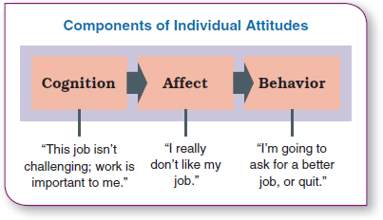
Attitude Components
Cognitive component
Affective component
Behavioral component

Slide 7
Job satisfaction
Job satisfaction
  The degree to which an individual feels positively or negatively about a job.
Job satisfaction is influenced by work itself, pay, promotion opportunities, supervision and co-workers.
There is a strong relationship between job satisfaction and absenteeism, as well as turnover.
Notes:
Job satisfaction
One measure of QWL is job satisfaction.
This is the degree to which an individual feels positively or negatively about various aspects of the job.
Facets of job satisfaction that can be handled through job design in the attempt to improve attitudes and raise the QWL include satisfaction with such things as pay, tasks, supervision, co-workers, work setting and advancement opportunities.
Researchers know that there is a strong relationship between job satisfaction and absenteeism.
Workers who are more satisfied with their jobs attend more regularly; they are absent less often than those who are dissatisfied.
There is also a relationship between job satisfaction and turnover. Satisfied workers are more likely to stay and dissatisfied workers are more likely to quit their jobs. Both of these findings are important, since absenteeism and turnover are costly in terms of the additional recruitment and training that are needed to replace workers, as well as in the productivity lost while new workers are learning how to perform to expectations.

Slide 8
Job characteristics model (JCM)
A framework for analyzing and designing jobs that identifies five primary core job dimensions, their interrelationships, and their impact on outcomes.
The model allows managers to create jobs that best fit people’s needs.
Notes:
Another approach to job design is the vertical expansion of a job by adding planning and evaluating responsibilities—job enrichment. Job enrichment increases job depth, which is the degree of control employees have over their work. In other words, employees are empowered to assume some of the tasks typically done by their managers. Thus, an enriched job allows workers to do an entire activity with increased freedom, independence, and responsibility.
Even though many organizations implemented job enlargement and job enrichment programs and experienced mixed results, neither
approach provided an effective framework for managers to design motivating jobs. But the job characteristics model (JCM) does. It identifies five core job dimensions, their interrelationships, and their impact on employee productivity, motivation, and satisfaction.

Slide 9
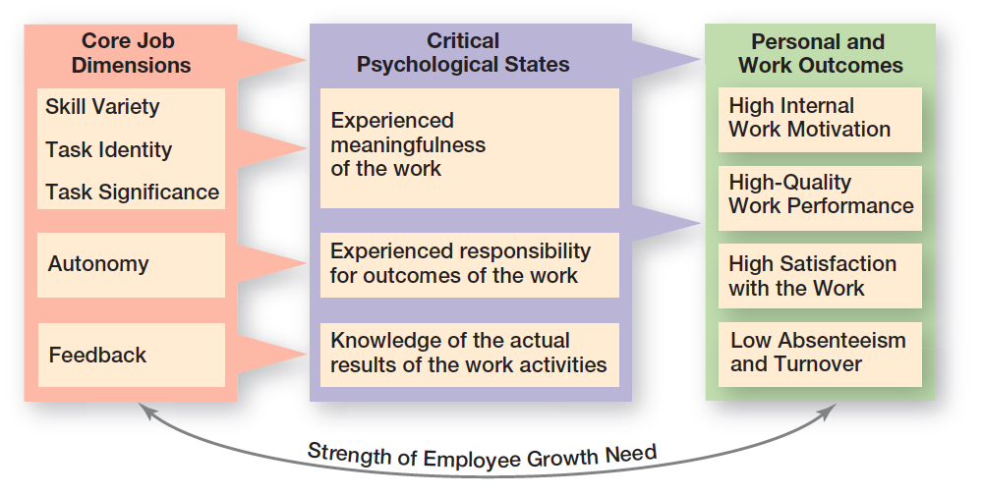
Job Characteristics Model
Notes:
Source: “Job Characteristics Model,” from Work Redesign, by J. R. Hackman & G. R. Oldham. Copyright © 1980 by Addison- Wesley (a division of Pearson). Reprinted with permission.

Slide 10
Job stress
Stress is a state of tension experienced by individuals facing extraordinary demands, constraints or opportunities.
The things that cause stress are called stressors. They all have potential to influence work attitudes, behaviour and job performance.
Notes:
Job stress
The jobs that people are asked to perform, and the relationships and circumstances under which they have to do them, are often causes of significant stress. Formally defined, stress is a state of tension experienced by individuals facing extraordinary demands, constraints or opportunities.
This figure presents a model of stress that indicates its major sources or causes and its consequences.

Slide 11
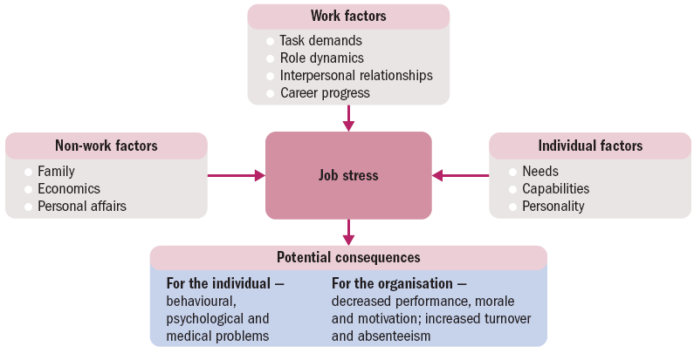
Sources of stress
Work factors have obvious potential to cause stress.
Notes:
Sources of stress
The things that cause stress are called stressors. Whether they originate directly in the work setting or in personal and non-work situations, they all have the potential to influence one’s work attitudes, behaviour and job performance.
Work factors have an obvious potential to create job stress. Today, we often experience such stress in long hours of work, excessive emails, unrealistic work deadlines, difficult bosses or co-workers, and unwelcome or unfamiliar work.
Two of the common work-related stress syndromes are
(1) set up to fail, where the performance expectations are impossible or the support is totally inadequate for the task, and
(2) mistaken identity, where the individual ends up in a job that doesn’t match talents or that he or she simply doesn’t like.
Personal factors are also sources of potential stress for people at work. Such individual characteristics as needs, capabilities and personality can influence how one perceives and responds to the work situation.
Researchers identify a Type A personality that is high in achievement orientation, impatience and perfectionism.
Type A people are likely to create stress in circumstances that others find relatively stress-free. In this sense, Type A people bring stress on themselves.
The stressful behaviour patterns of Type A personalities include the following:
• always moving, walking and eating rapidly
• impatient, hurrying others, disliking waiting
• doing, or trying to do, several things at once
• feeling guilty when relaxing
• trying to schedule more in less time
• using nervous gestures such as a clenched fist
• hurrying or interrupting the speech of others.
Finally, stress from non-work factors can have spill over effects that affect the individual at work. Stressful life situations including such things as family events (e.g. the birth of a new child), economics (e.g. a sudden loss of extra income) and personal affairs (e.g. a preoccupation with a bad relationship) are often sources of emotional strain. Depending on the individual and his or her ability to deal with them, preoccupation with such situations can affect people’s work and add to the stress of work–life conflicts.

Slide 12
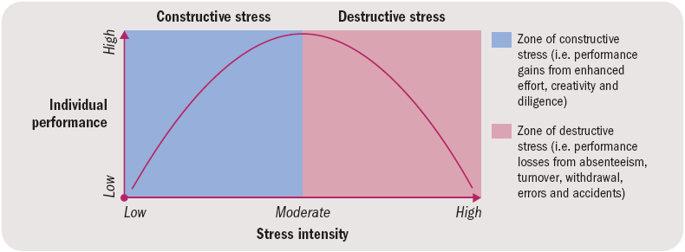
Constructive and Destructive Stress
Notes:
Consequences of stress
The model demonstrates that, up to a point, moderate levels of stress can be healthy as they move us towards performing at our best. Above these levels, however, stress can become a destructive force in our lives.
Constructive stress acts in a positive way for the individual and/or the organisation. It occurs in moderation and proves energising and performance enhancing. The stress is sufficient to encourage increased effort, stimulate creativity and enhance diligence in a person’s work, while not overwhelming the individual and causing negative outcomes. Individuals with a Type A personality, for example, are likely to work long hours and to be less satisfied with poor performance. For them, challenging task demands imposed by a supervisor may elicit higher levels of task accomplishment. Even non-work stressors such as new family responsibilities may cause them to work harder in expectation of greater financial rewards.

Slide 13
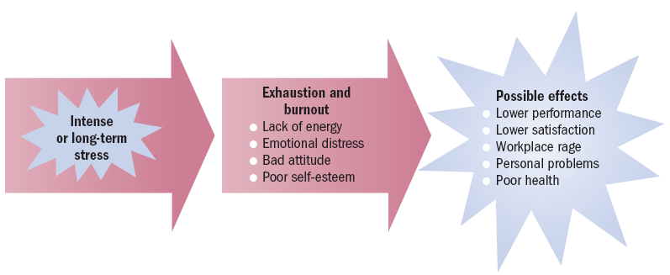
Consequences of stress
Notes:
Destructive stress is dysfunctional for the individual and/or the organisation. It occurs as intense or long-term stress that overloads and breaks down a person’s physical and mental systems. Destructive stress can lead to job burnout — a form of physical and mental exhaustion that can be incapacitating both personally and with respect to one’s work. Productivity can suffer as people react to very intense stress through turnover, absenteeism, errors, accidents, dissatisfaction and reduced performance. Today as well, there is increased concern for another job consequence of excessive stress, workplace rage — overtly aggressive behaviour towards co-workers and the work setting in general.

Slide 14
Stress management strategies
Ways to cope with workplace stress:
  Take control of the situation, know your limits.
  Pace yourself with a prioritised plan.
  Clarify your role in the workplace with bosses and co-workers.
  Discuss your problems with others who care about you.
  Do things for others.
  Engage in regular physical activity.
  Balance work and recreation.
Notes:
Stress management strategies
There are at least four reasons managers should also be skilled at dealing with workplace stress: humanitarianism, productivity, creativity and return on investment.
Personal wellness is a term used to describe the pursuit of one’s physical and mental potential through a personal health promotion program. This form of preventive stress management recognises the individual’s responsibility for enhancing his or her personal health through a disciplined approach to such things as smoking, alcohol use, maintaining a nutritious diet, and engaging in a regular exercise and physical fitness program. The essence of personal wellness is a lifestyle that reflects a true commitment to health.
Six ways to cope with workplace stress
1. Take control of the situation. Do your best, know your limits and avoid unrealistic deadlines.
2. Pace yourself. Plan your day to do high-priority things first, but stay flexible and try to slow down.
3. Open up to others. Discuss your problems, fears and frustrations with those who care about you.
4. Do things for others. Think about someone else’s needs, and try to help satisfy those needs.
5. Exercise. Engage in regular physical activity as recommended by your doctor.
6. Balance work and recreation. Schedule time for recreation, including holidays from your work.

